Slide 1


Thakur Polytechnic
Blog Web Application
Presented by
Guided by
Vijay Tiwari (32)
Anurag Pandey (33)
Viraj Gavas (52)
Akash Adarkar (60)
Mr. Chintamani Chavan
Submitted for the partial fulfillment
of
DIPLOMA
in
INFORMATION TECHNOLOGY
Information Technology
June - 2021

Slide 2
Content
Abstract
Introduction
Objectives
Literature review
Methodology
Tools and technologies
Findings and results
Applications
Conclusion
Future scope
References
Blog-Web Application
June - 2021
‹#›

Slide 3
1. Abstract
“In Our project of Blog Web App we built a web application in which in one person with knowledge of any specific topic can write an article and post it share it with the people worldwide so that they can use it research purposes , entertainment , education ,business promotions and many others fields .In the Project of Blog Web app
We have used Django as a framework of python and other front - end technologies for building this site .This web site has almost all the features that compete with the modern day site and we made responsive so that we can also use it on mobile screens.It also has password change / reset functionality through email (SMTP) if the users forget their passwords “
Blog-Web Application
June - 2021
‹#›

Slide 4
2. Introduction
Blog Web-app enables the users to create innovative and attractive articles with photos in just a few simple steps.
The user just needs to upload some images of his choice and can also upload the information or can select from the given category list.
This website will provide a personalized environment that would contain the data in motion with images.
So, the main purpose of a blog is to connect you to the relevant audience.
Blog-Web Application
June - 2021
‹#›

Slide 5
3. Objectives
main objective was to build while learning i.e. Django
then create web application which lets users share content online through articles
imply as much as possible from the different technologies we learnt and read from the literature survey
Blog-Web Application
June - 2021
‹#›

Slide 6
4. Literature review
Sr. No. | Author | Title | Source | Findings/Remark
1 | Tomayess B.T Issa (2013) | From Social Networking for Web-Based Communities | https://www.researchgate.net/publication/262401330_Social_networking_for_web-based_communities | Basic idea for social networking
2 | Matthew N.O Sadiku, Adedamola A.Omotoso, Sarhan M Musa (2019)ga | Social Networking | https://www.researchgate.net/publication/333695257_Social_Networking
3 | Karan Gupta, Anita Goel 2014 | Blog in web application: a software engineering perspective | https://www.inderscience.com/info/inarticle.php?artid=64789 | Importance of Web Application
4 | Zuwati Hasim 2011 | Issues and Challenges of using Web Blogs as a Medium for Research Communication | https://www.researchgate.net/publication/273493095_Issues_and_challenges_of_using_web_blogs_as_a_medium_for_research_communication | Learnt How blog is important in research purposes and information gathering and how we can make application show more relevant results
5 | Ashish Arora | Web Application Development | https://www.academia.edu/34579745/Web_Application_Development | Basic idea of web app , working advantages and disadvantages .
6 | Karan Gupta, Anita Goel 2014 | Blog in web application: a software engineering perspective | https://www.inderscience.com/info/inarticle.php?artid=64789 | Importance of Web Application
7 | Kedar Jain 2019 | A python Book:Beginning Python,advanced Python and Python Exercises | https://www.academia.edu/41829928/A_Python_Book_Beginning_Python_Advanced_Python_and_Python_Exercises?sm=b | Learnt basic of python programing language
8 | V. Myalapalli 2015 | Optimizing Front -end Applications and Javascript | https://www.academia.edu/13009088/Optimizing_Front_End_Applications_and_JavaScript | Learn Javascript
9 | Obak Kando Adrian Holovaty | The Definitive Guide to Django: Web Development Done Right | https://www.academia.edu/44025451/The_Definitive_Guide_to_Django_Web_Development_Done_Right_Adrian_Holovaty_Jacob_K_Moss | Guide for Django Framebook
10 | Majo Flosa | Javascript Reference | https://www.academia.edu/13009088/Optimizing_Front_End_Applications_and_JavaScript | Reference for javascript
11 | Maher Hossain | Bootstrap | https://www.academia.edu/36797193/Bootstrap | Reference of Bootstrap
12 | Waseem Wsm | SQlite DATABASE | https://www.academia.edu/39057071/SQLite_DATABASE | Reference for Sqlite
Blog-Web Application
June - 2021
‹#›

Slide 7
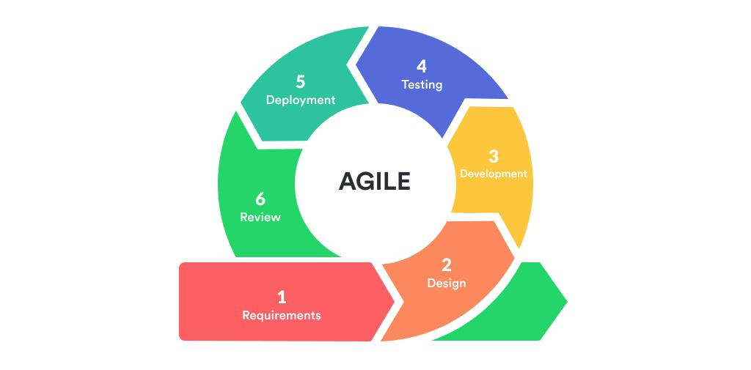
5. Methodology
The methodology we followed for this project was agile methodology
AGILE methodology is a practice that promotes continuous iteration of development and testing throughout the software development life cycle of the project. In the Agile model, both development and testing activities are concurrent, unlike the Waterfall model.
Blog-Web Application
June - 2021
‹#›

Slide 8
With the help of Agile methodology ,we build the web application in small chunks and without messing up the other components and features of the project
Basic necessary elements for the blog web app
Add additional features like comments , tags , header images etc
User Authentication
Database
User Authorization
Templates
Blog-Web Application
June - 2021
‹#›

Slide 9

6. Tools and technologies
Django
Third Party Applications
Crispy Forms
CK-editor
Pillow
Python
HTML
Css
Bootstrap
SQLite
Blog-Web Application
June - 2021
‹#›

Slide 10
7. Findings and results
Following are the snap-shots of the website
Blog-Web Application
June - 2021
‹#›

Slide 11
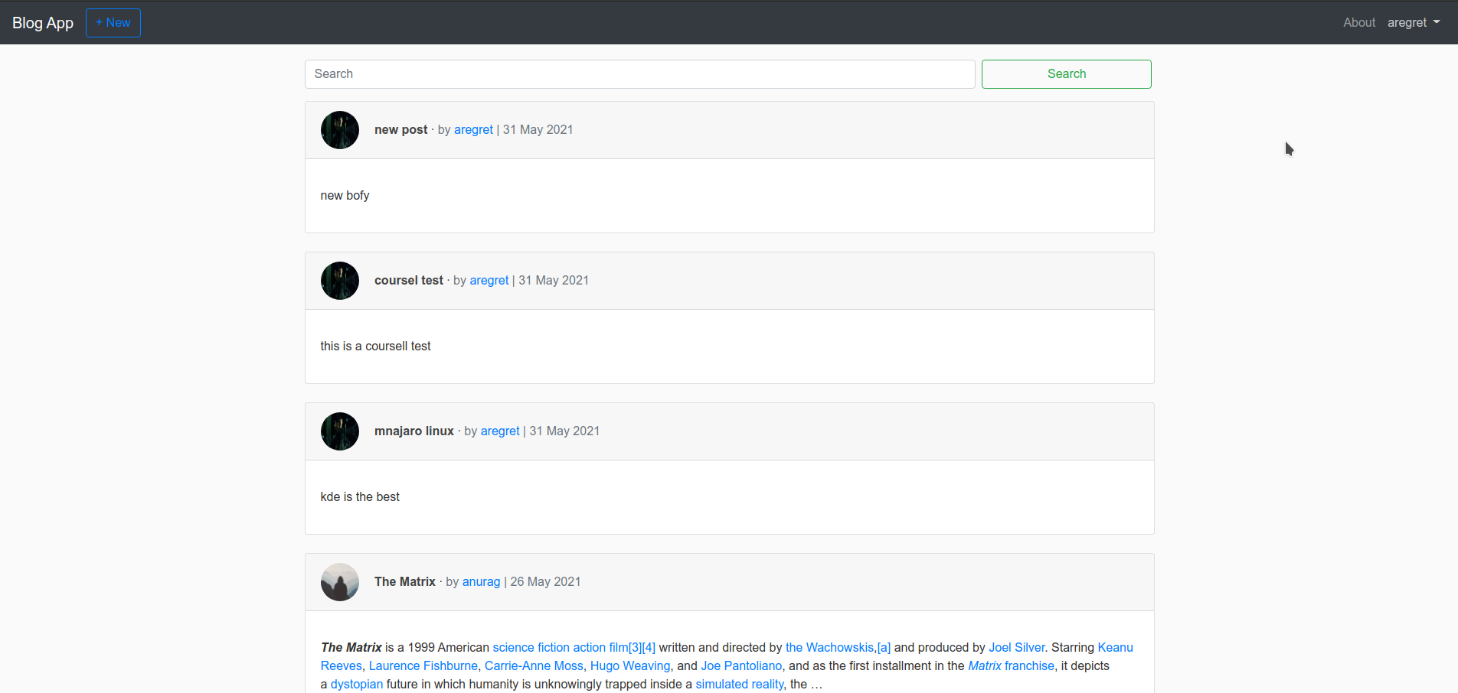
Home Page
Navigation Bar
Create New Post
Post List
Account Info
Search Bar

Slide 12
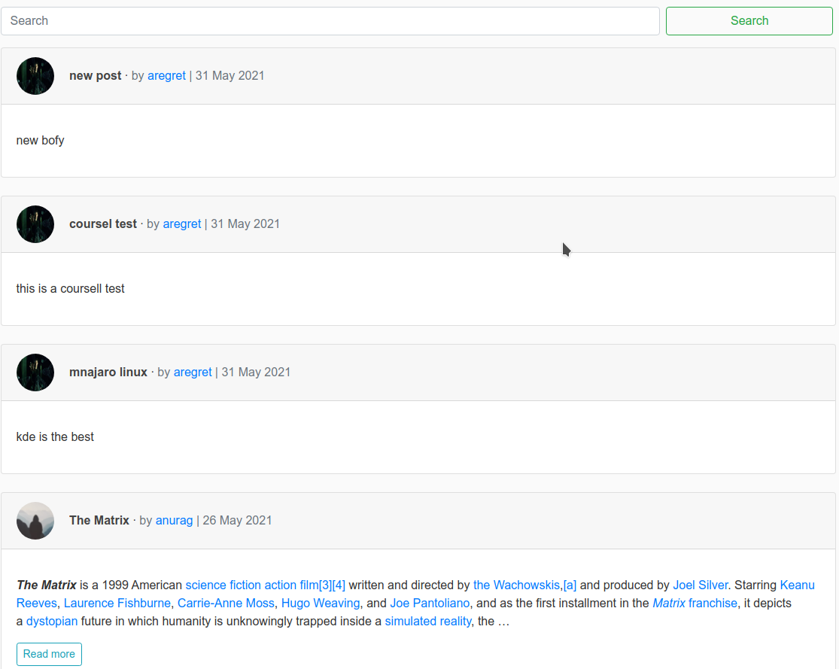
List View
SEARCH BAR
AUTHOR
PROFILE PIC
ARTICLE BODY
AUTHOR
ARTICLE TITLE

Slide 13
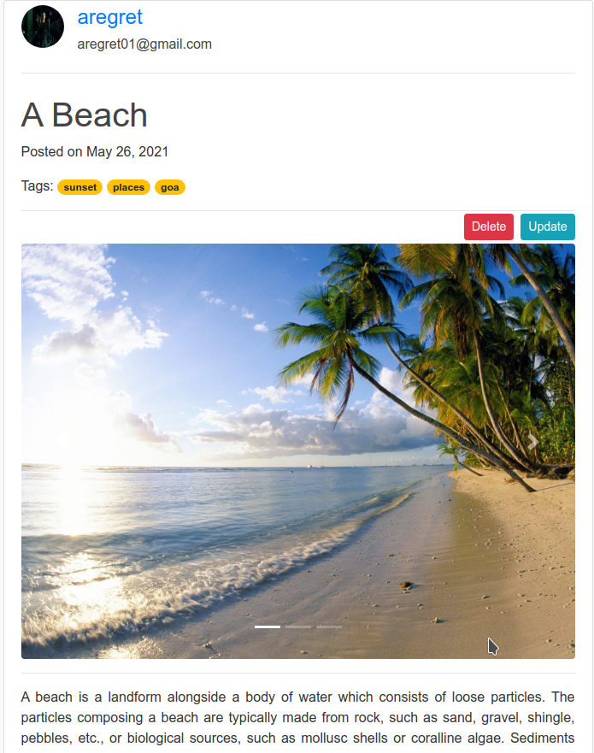
POST DETAIL (1/2)
ARTICLE TITLE
USER PROFILE
ARTICLE
UPDATE / DELETE
COURSEL IMAGES
TAGS

Slide 14
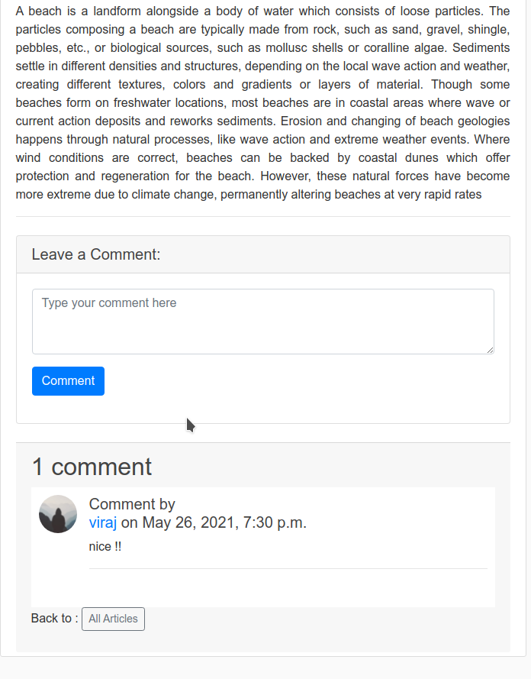
POST DETAIL (2/2)
POST
BODY
COMMENT
BOX
ACCOUNT INFO
COMMENT
COMMENT SECTION

Slide 15
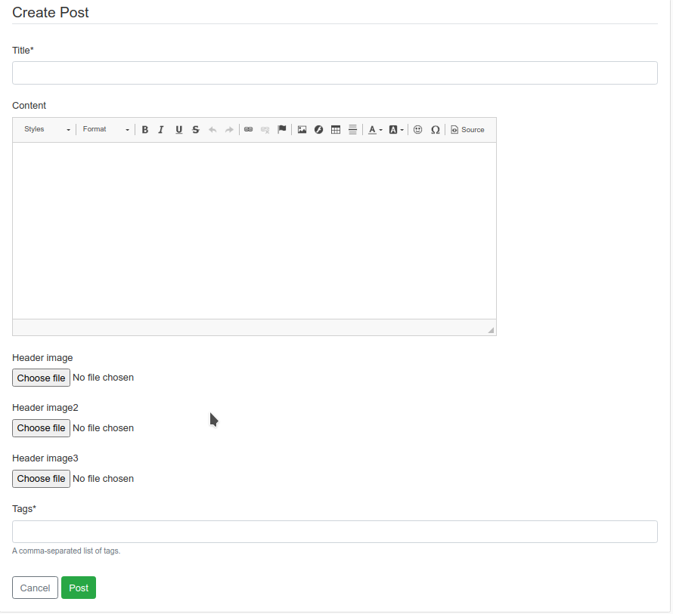
CREATE POST
POST TITLE
POST BODY
HEADER IMAGE
TAGS
POST

Slide 16
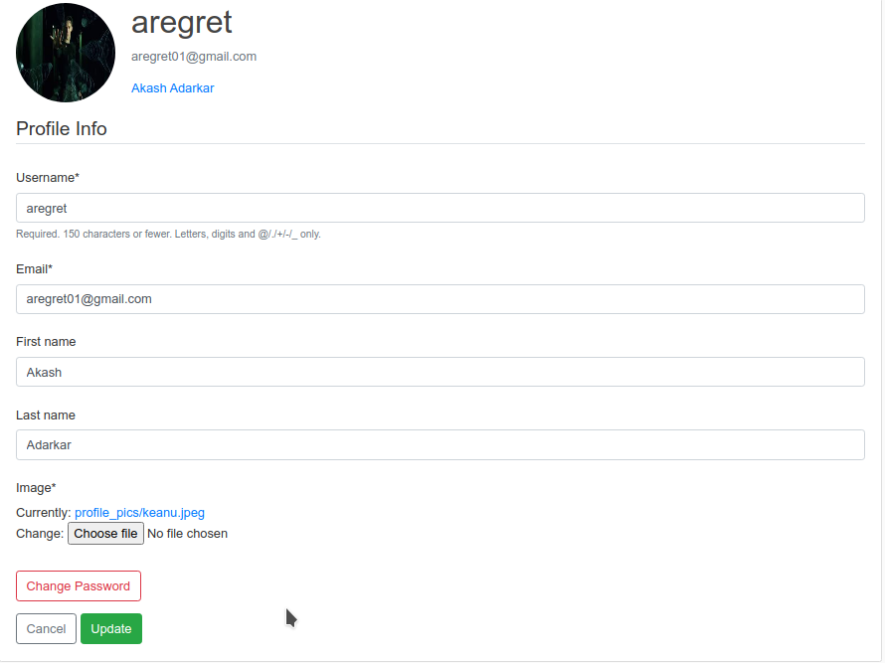
PROFILE SETTINGS
CHANGE USERNAME / EMAIL
USER PIC / USERNAME / EMAIL /
FULL NAME
FULL NAME
FIELD
CHANGE PASSWORD
UPDATE

Slide 17
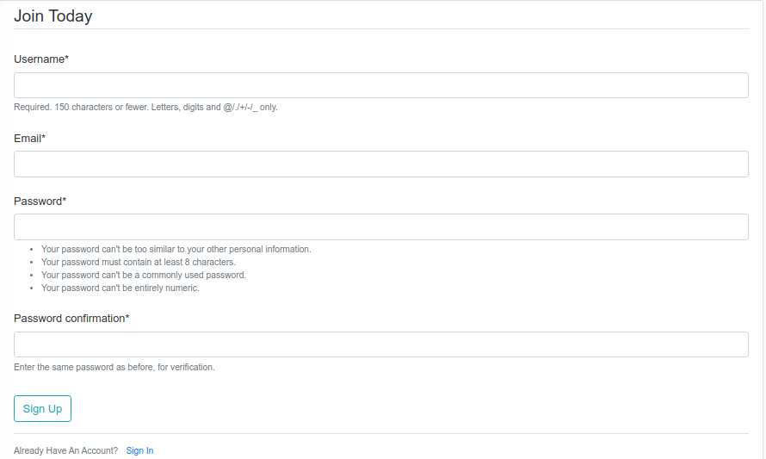
Registration
USERNAME
EMAIL
CONFIRM PASSWORD
PASSWORD
SIGN UP BUTTON

Slide 18
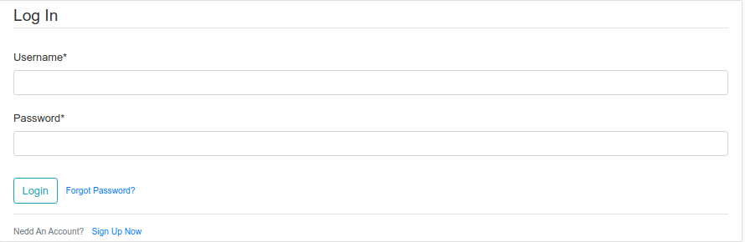
Log In Screen
USERNAME
LOGIN BUTTON
PASSWORD
FORGET PASSWORD LINK

Slide 19
8. Conclusion
Our project is only humble venture to satisfy the needs to manage their project work .
Several user friendly coding have also adopted .this package shall prove to be a powerful package is satisfying all the requirements of the school .The objective of software planning is to provide a framework that enables the user to make reasonable estimates made within limited time frame at beginning of the software project should be updated regularly project progresses
Blog-Web Application
June - 2021
‹#›

Slide 20
9. Future scope
add more functionality to profile page of user
add more models for fields in user and post
deploy the website online so that people can access it
make more appealing templates for the users
add like functionality for posts
add page to show the list of post and update and deletion options on that page
add themes for user comfort.
add tags
add more media content functionality i.e videos , gifs etc
add replies to comments
add chat options so that users and talk to the author directly
Blog-Web Application
June - 2021
‹#›

Slide 21
10. References
Ashish‌‌ Arora‌‌ Web‌‌ Application‌‌ Development‌
Zuwati Hasim Issues and Challenges of using Web Blogs as a Medium for Research Communication
Karan Gupta, Anita Goel (2014) Blog in web application: a software engineering perspective
Kedar Jain (2019) A python Book:Beginning Python,advanced Python and Python Exercises
Daniel J LeBlanc (2015) Photo Blog Web Application using Twitter Bootstrap
Adamya Shyam (2020) A Django based Educational Resource sharing website
Obak Kando Adrian Holovaty The Definitive Guide to Django: Web Development Done Right
V. Myalapalli (2015) Optimizing Front -end Applications and Javascript
Matthew N.O Sadiku, Adedamola A.Omotoso, Sarhan M Musa (2019) Social Networking
Tomayess B.T Issa(2013 Social Networking for Web -Based Communities
Blog-Web Application
June - 2021
‹#›

Slide 22


